Slide 1
Unix Introduction
Janos Binder - janos.binder@embl.de

Slide 2
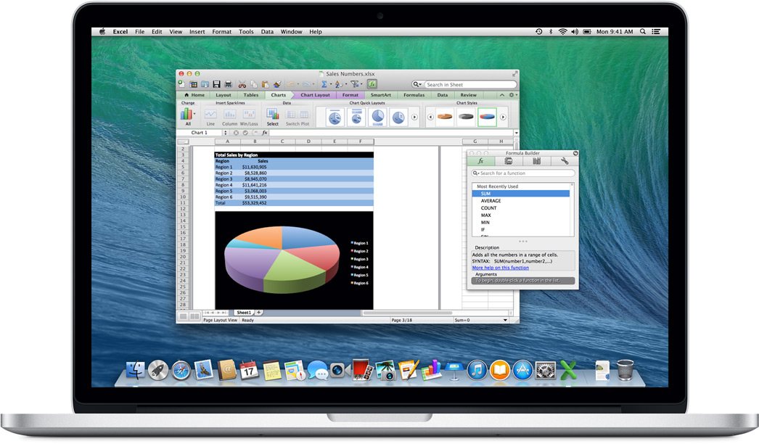

Notes:
Unix in everyday live
Some about the past
Why unix is important in science

Slide 3

Biology in 2014
Omics Era
Several Go of data / experiment
Personalized Medicine

Slide 4

Why using Unix in Biomedical Research?
Free
Fast
Ethics
Open
Easy & documented!

Slide 5
What do you do with Unix in Biology?
File manipulation
Sequences
Interaction networks
Research articles
Spectrum
…
Analysis
Calling programs (R, Perl, Python, Java, etc…)
Generating knowledge from raw information
Statistics
Filtering
…

Slide 6
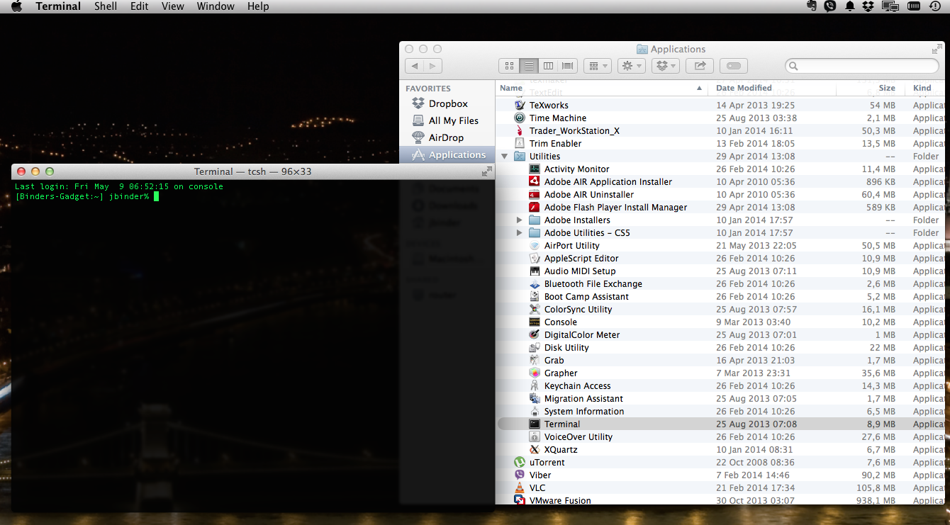
OSX terminal

Slide 7
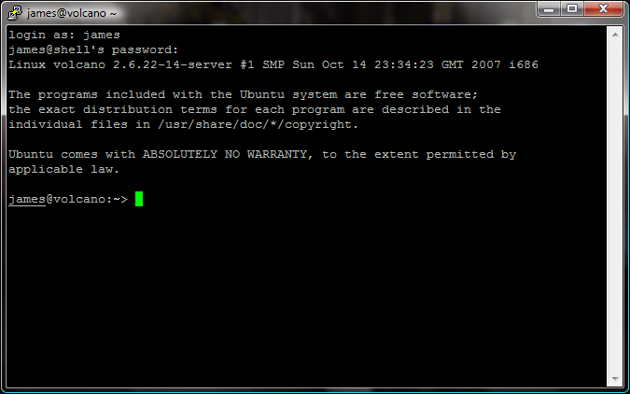
Putty

Slide 8
Why do we use terminal
To learn how to work on a server, because:
Common collaborations/projects
More computing power
Safer (backups)

Slide 9
What do you do with Unix in Biology?
File manipulation
Sequences
Interaction networks
Research articles
Spectrum
…
Analysis
Calling programs (R, Perl, Python, Java, etc…)
Generating knowledge from raw information
Statistics
Filtering
…
Part 1
Part 2

Slide 10
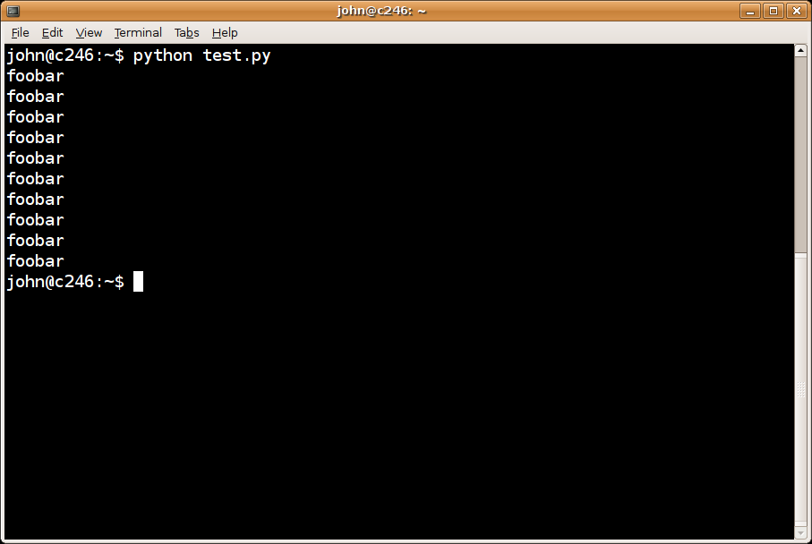
The Shell – What the (s)hell is this?
Piece of software that provides an interface for users of an operating system

Slide 11
The Shell – Tips
Previous command:
Auto-Complete:
Emergency Stop:
Going forward/back:
TAB
Ctrl
C
Ctrl
Z
Alt
Alt

Slide 12
Step 0
Getting help

Slide 13
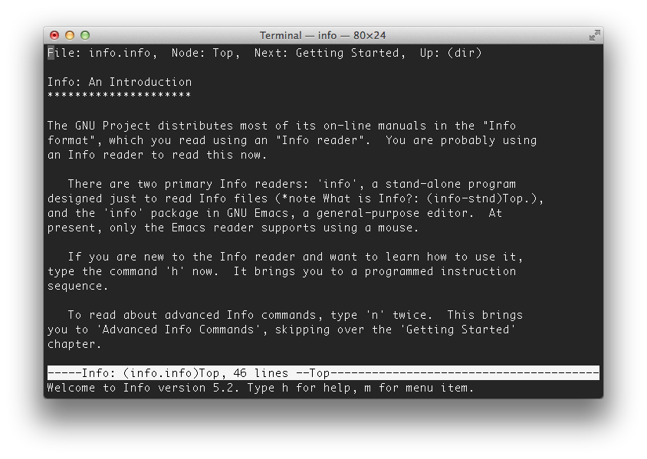
info [command]
The info command provides help

Slide 14
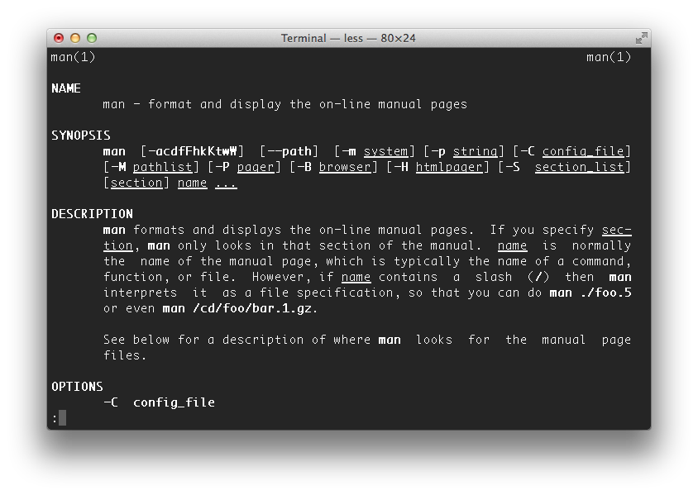
man [command]
The man command is a more traditional way to get help

Slide 15
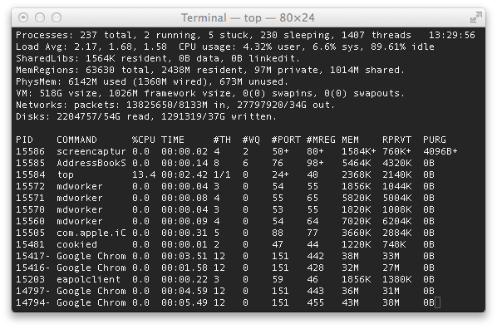
What’s going on: top
Display the list of running processes
To kill a program type ‘k’ on the keyboard followed by the PID

Slide 16
Step 1
Browsing around

Slide 17
Everything’s a file
/
/
user
alice
bob
desktop
bin
etc
trash
todo.txt
images
/user
/user/alice
/user/alice/desktop
/user/alice/desktop/todo.txt
Path

Slide 18
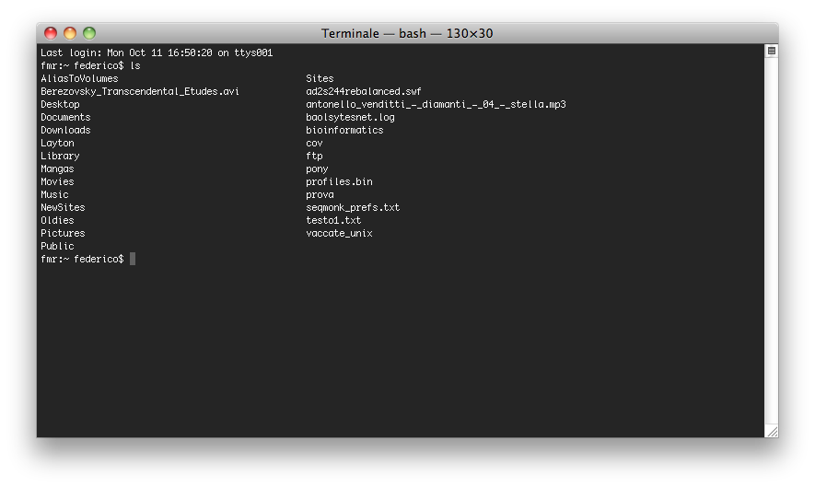
ls [directory] (list)
The ls command lists the contents of your current working directory

Slide 19
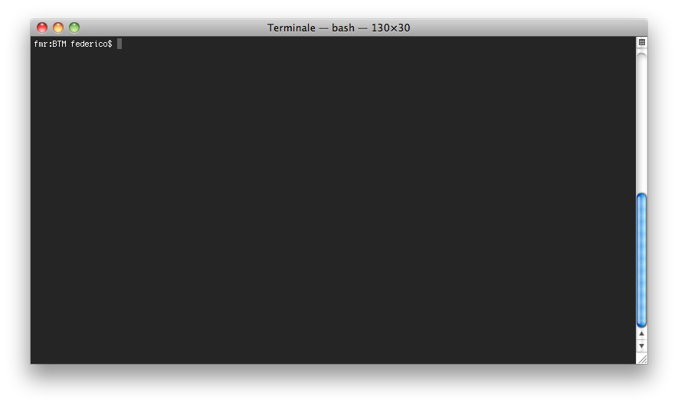
clear (clear screen)
The clear command clears the screen

Slide 20
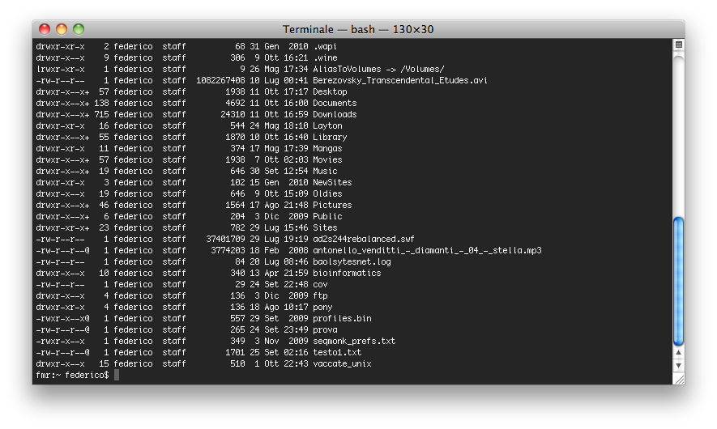

ls -al [directory] (long list)
The -al parameters show all files and their attributes
Try also –ltrh, it shows all files ordered by modification date
Notes:
-h human readible

Slide 21
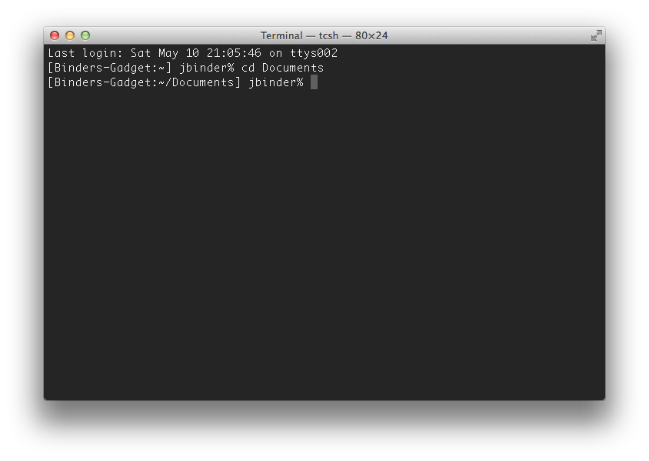
cd [directory]
The cd command changes the current working directory to ‘directory’
One level up: ..
This directory: .
Your home: ~

Slide 22
mkdir directory (make directory)
The mkdir command creates a new directory

Slide 23
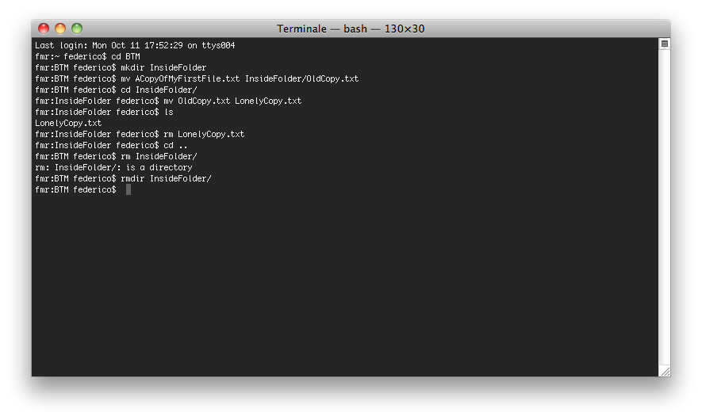
rmdir directory (remove directory)
The rmdir command removes (a) directory

Slide 24
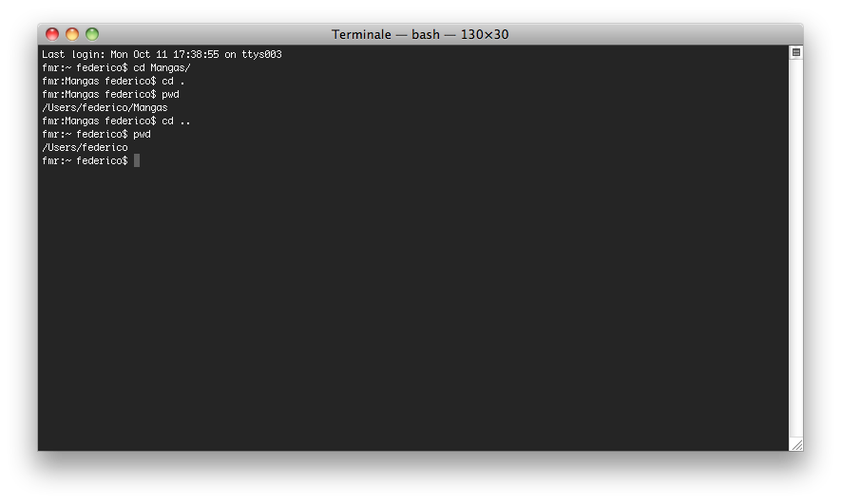
The directories . and ..
. (a full stop) refers to the current directory,
.. (two full stops) refers to the parent directory

Slide 25
pwd (print working dir)
The pwd command prints the absolute pathname of the current working directory

Slide 26
Step 2
Handling files

Slide 27
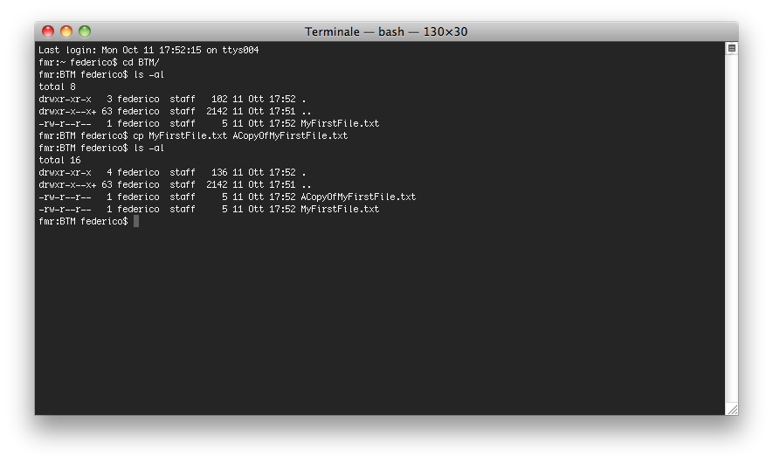
cp file1 file2 (copy)
The cp command makes a copy of file1, naming it file2

Slide 28
mv file1 file2 (move)
The mv command moves file1 into file2
(if file2 is in the same directory, file1 is renamed)

Slide 29
rm file (remove)
The rm command removes (a) file

Slide 30
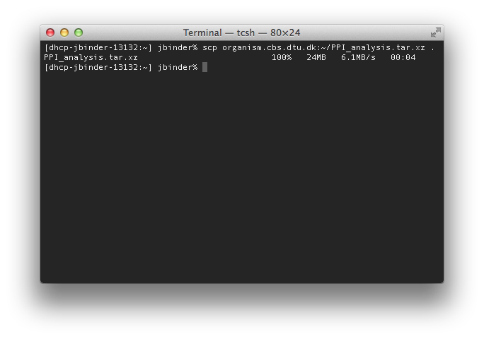
scp server:file1 file2 (secure copy)
scp copies a file from a server to a local place
scp file1 server:file2 also works

Slide 31
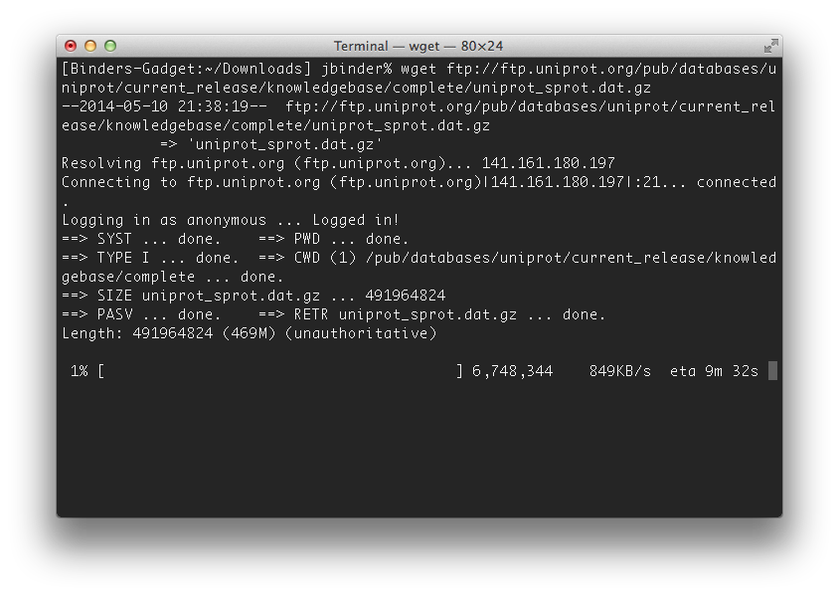
wget url
wget can download files

Slide 32
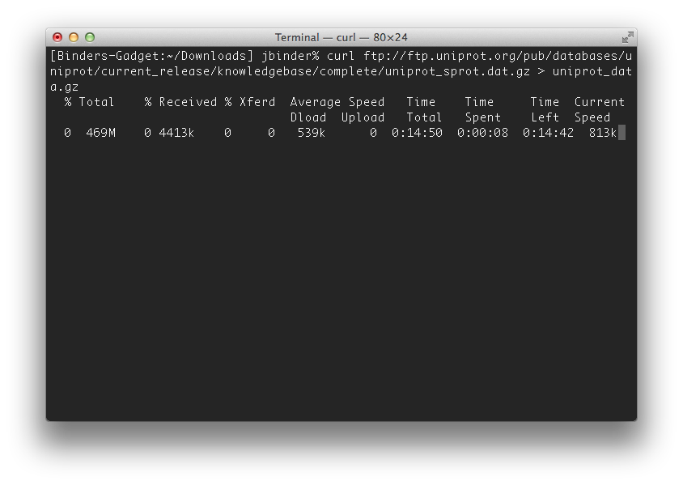
curl url > filename
curl retrieves data from various internet services

Slide 33
Step 3
Files content

Slide 34
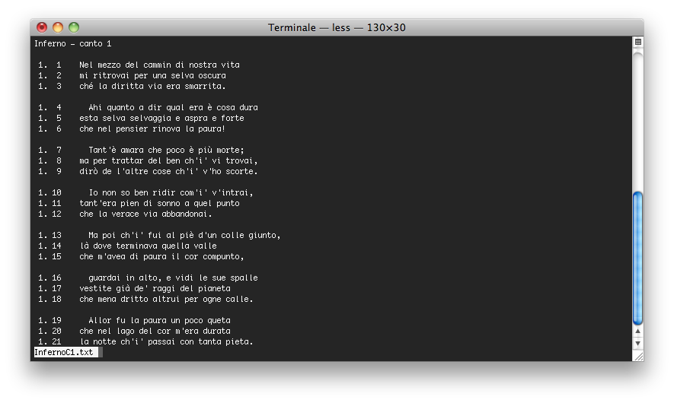
less file1
The less command shows the contents of a file
on the screen, one page at a time

Slide 35
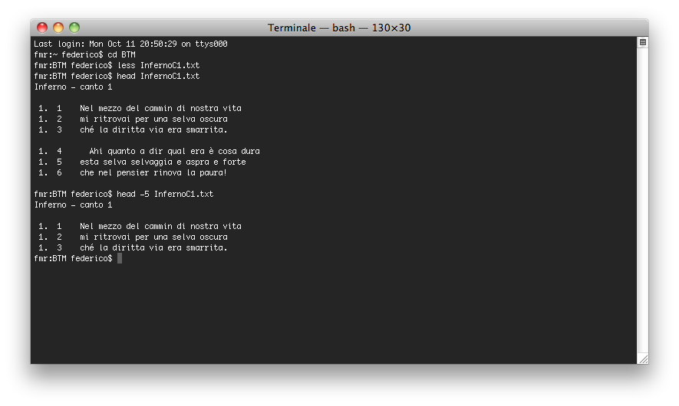
head [-n] file
The head command shows
the first 10 (or n) lines of a file

Slide 36
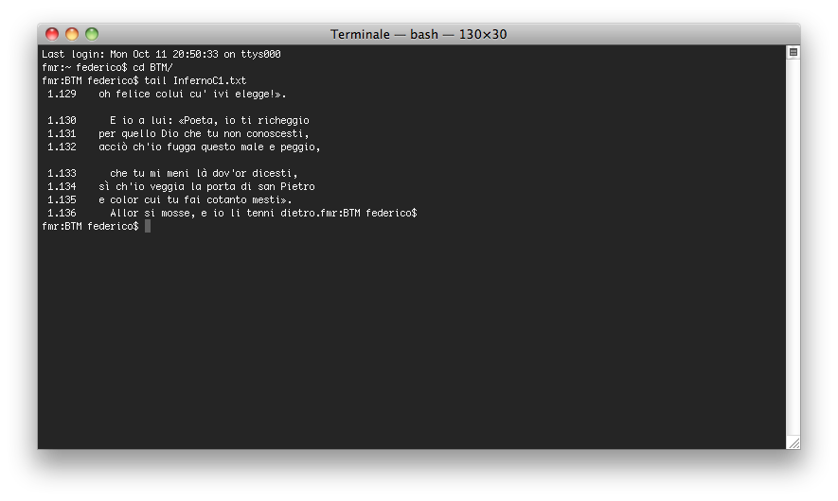
tail [-n] file
The tail command shows
the last 10 (or n) lines of a file

Slide 37
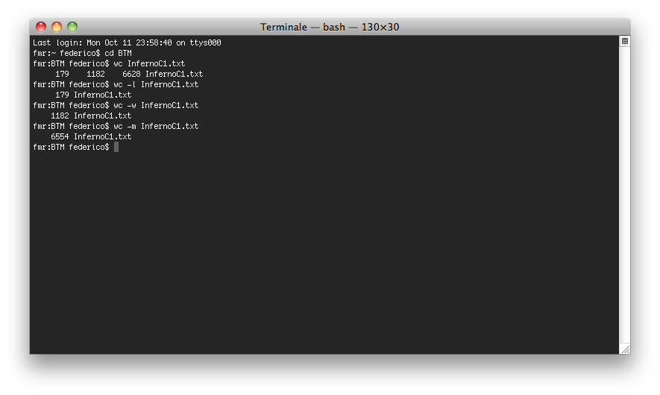
wc [-lmw] file (word count)
The wc command returns
lines/words/characters number of a file

Slide 38
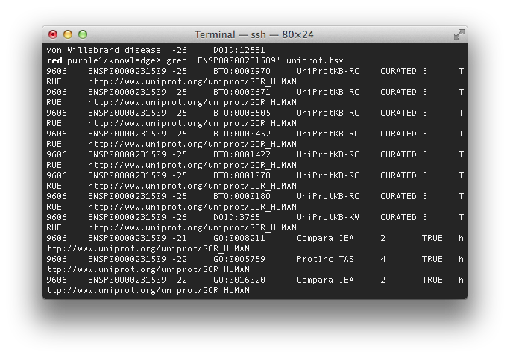
grep pattern file
Grep returns lines, which contain the pattern
-v flag return those line, which does not contain the pattern

Slide 39
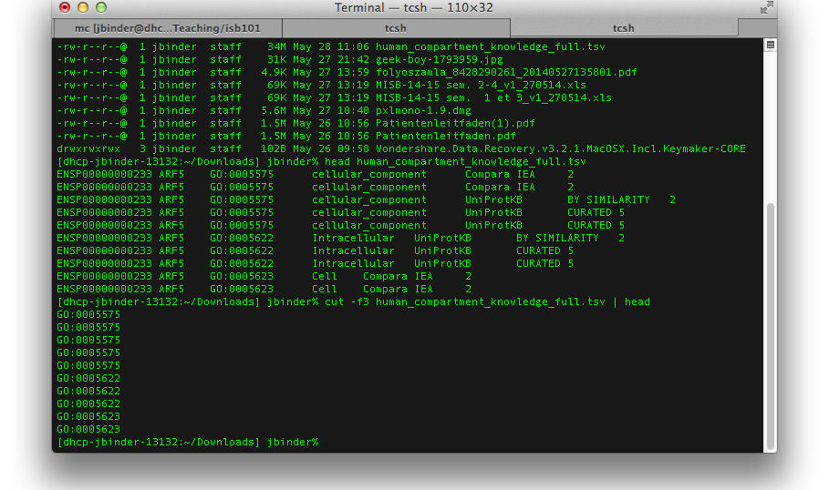
cut -f[number] [file]
Cut returns only the specified columns.

Slide 40
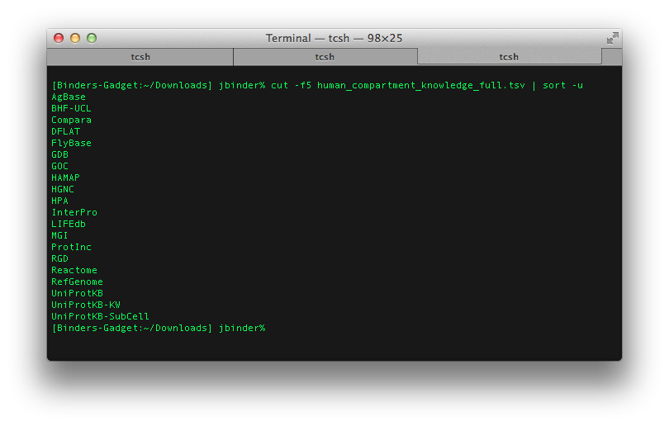
sort –u [file]
Sort the lines in a file. –u specifies that only unique lines should be listed (against duplication)

Slide 41

uniq [–c] [file] (unique)
Prints only unique lines (similar –u in sort). –c defines that it counts also the occurence

Slide 42
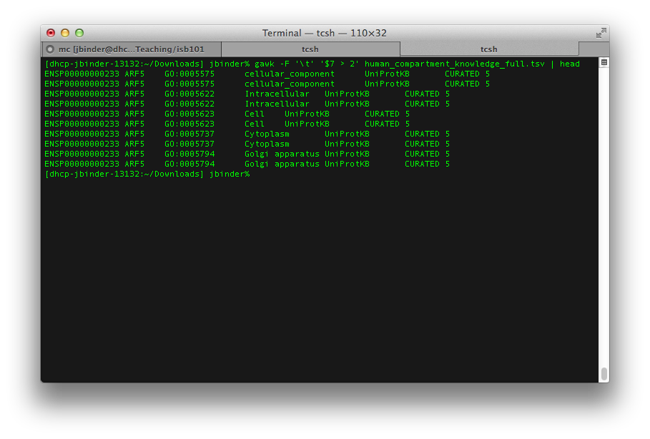
gawk “short program” file
(g)awk is a language for data manipulation – some examples will come during the tutorial

Slide 43
Take home message
Unix/Linux is the most widely used operating system in bioinformatics
Unix/Linux is used to handle files and to run analysis on very large experiments, by calling external programs
You can manipulate your files through command lines
You can launch programs by the command line (next talk)
Google is the best way to find information about particular command lines

Slide 44
Step 4
Setting up programs

Slide 45
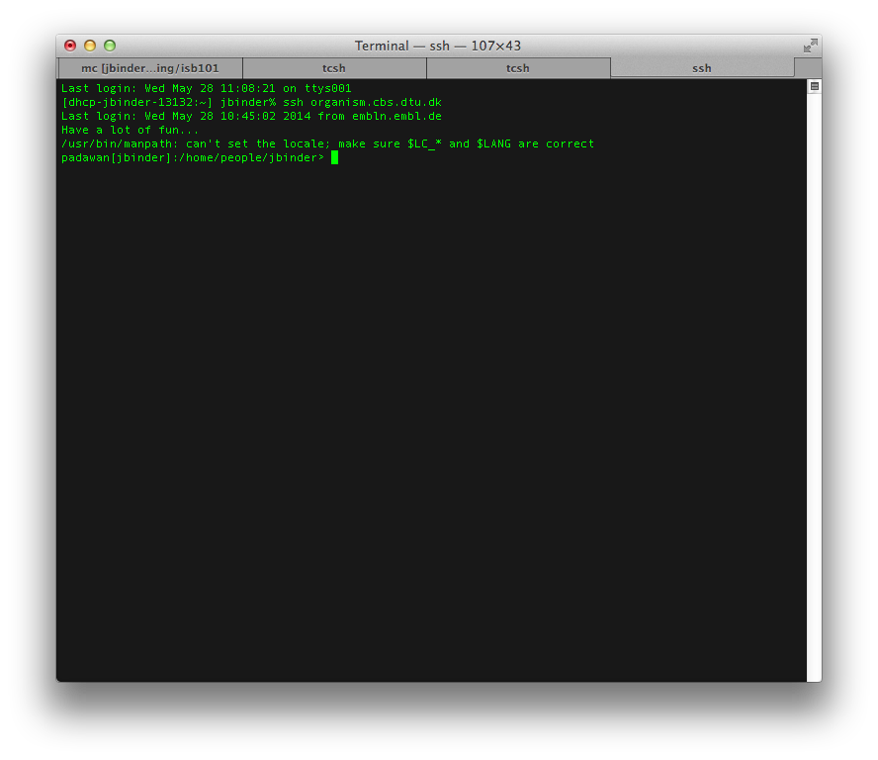
ssh
ssh allows to log in to a remote machine

Slide 46
chmod a+x file
chmod changes permission of a file. Here it becomes executable
Notes:
Check it out with ls -la

Slide 47
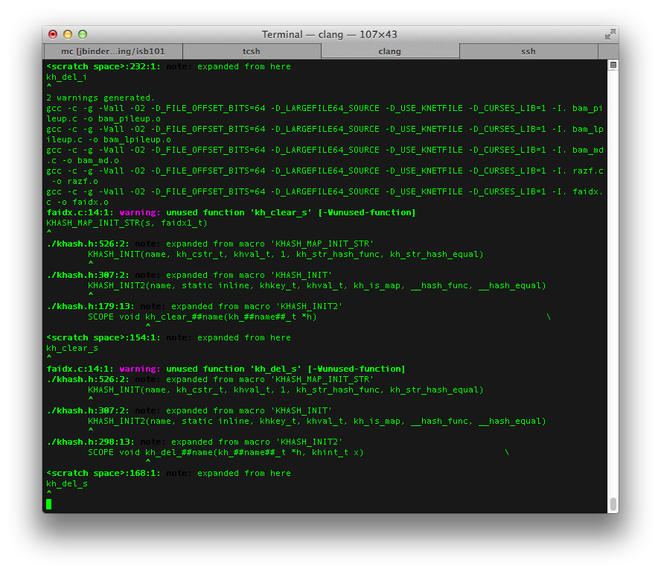
configure
configure adopt a program package for the local environment

Slide 48
make
make compiles and set ups a program package

Slide 49
Step 4
Pipelines and streams

Slide 50
Chaining programs

Slide 51
Pipes – Chaining programs
grep …| head’
The program is executed and the output is sent to the shell
The output is sent

Slide 52
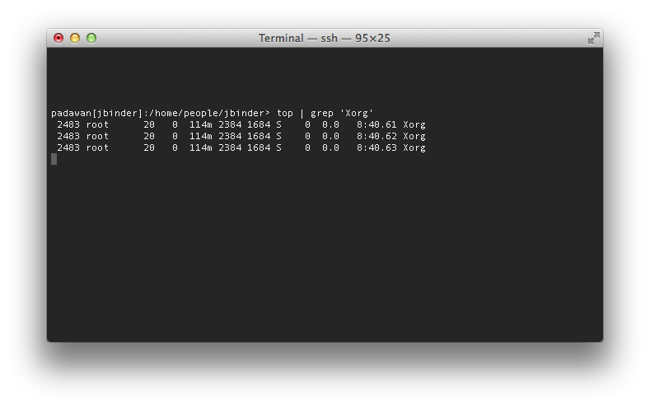
Checking whether Xorg is running: top | grep ‘Xorg’
Output only the line of ‘top’ containing the string ‘Xorg’

Slide 53
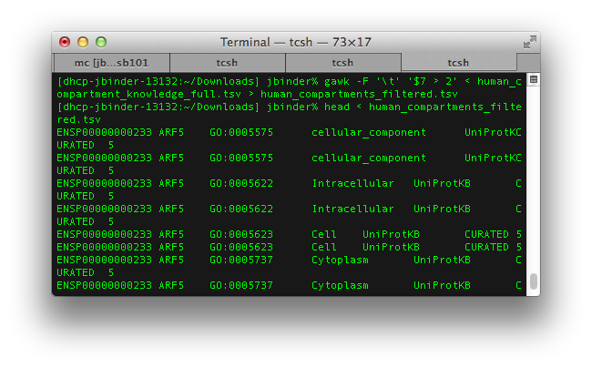
Redirecting standard input & output
< reads in a file, > write the results into a file

Slide 54
Introduction to bash scripting
Repeating steps is time-consuming and error-prone
Reproducible research ->
An automated solution is needed
UNIX – shell script

Slide 55
First script – Hello World
The first line defines what kind of program will interpret this script
echo – this command prints out text
“ denotes that it is a text – work also without it, but error prone
#!/bin/bash
echo "Hello World!"

Slide 56
Variables
Storing often used texts, numbers
Storing results of a calculation
Remember to the $
#!/bin/bash
HW="Hello World!"
echo $HW
echo "It is boring to print" $HW

Slide 57
Conditionals
Let you decide whether to perform an action or not, which based on the evaluation of the expression
An if-then-else construct:
#!/bin/bash
FILE="3_basic_conditionals.sh"
if [ -f $FILE ]; then
echo "FILE:" $FILE "exists!"
fi
if [ -f $FILE ]; then
echo "FILE:" $FILE "exists!"
else
echo "FILE:" $FILE "does not exists!"
fi

Slide 58
Streams and pipes - revisited
Storing the names of the files in a directory
But it shows also lists files_in_the_directory.txt
Piping the other way
A more clever solution:
ls -1 > files_in_the_directory.txt
less files_in_the_directory.txt
grep -v files_in_the_directory.txt < files_in_the_directory.txt | less
ls -1 | grep -v files_in_the_directory.txt > files_in_the_directory.txt
less files_in_the_directory.txt

Slide 59
Loops
To do stuff the “same” stuff more than once
#!/bin/sh
echo "We count to ten!"
for (( i = 1 ; i <= 10 ; i++ )) ; do
echo $i
done
#!/bin/sh
(( i = 1 ))
while (( i <= 10 )) ; do
echo $i
(( i++ ))
done
Notes:
http://linux.about.com/od/Bash_Scripting_Solutions/a/How-To-Write-Bash-For-Loops.htm

Slide 60
How do I execute a series of commands? Bash scripting
You can create scripts (e.g, “my_series_of_command.sh”) executing a series of Unix commands
#!/bin/bash
for i in $(seq 1 5)
do
echo "i is equal to: $i"
ls -l
done
You can execute the scripts via: sh my_series_of_command.sh
or chmod a+x my_series_of_command.sh; ./my_series_of_command.sh

Slide 61
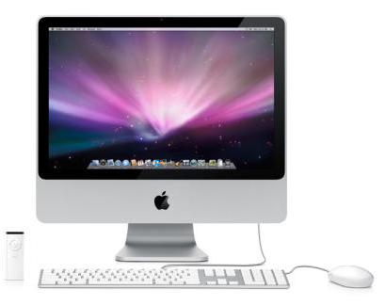

“Hey, Unix looks cool, but I have a Mac!”

Slide 62

Good news:
The recent Mac OS are Unix based.
So you were using it without realizing it
Mac OS has a shell, most of the commands (used in biology) are working directly!

Slide 63

“I’m using Windows, how can I try or install a Unix-like system?”

Slide 64
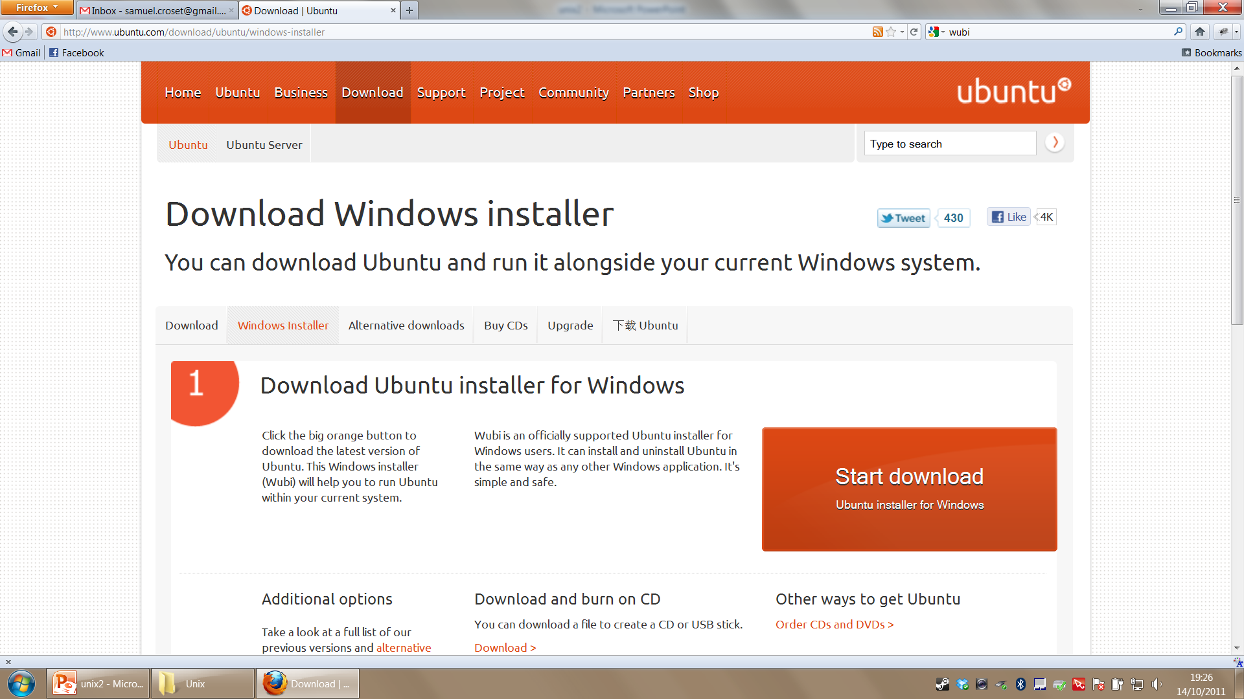
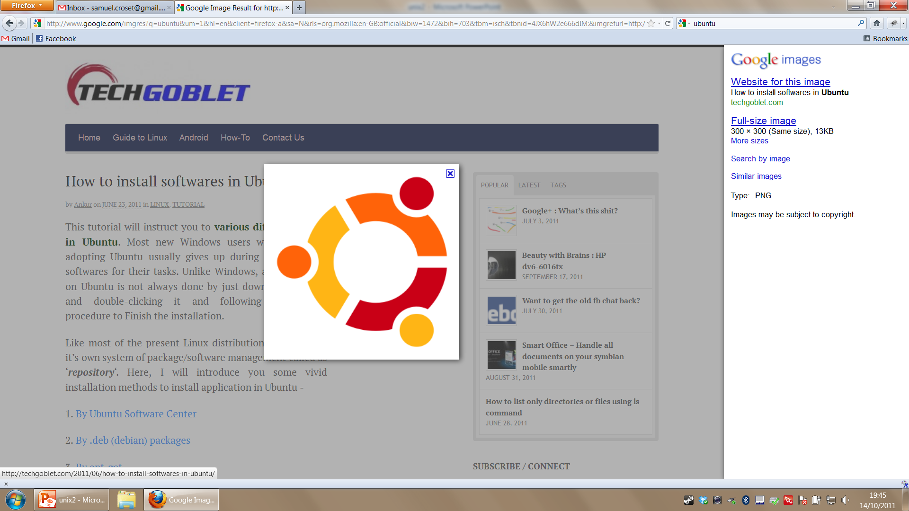
Try Wubi!
It will install Ubuntu on your Windows machine
You install it like a normal program inside Windows
When you will boot your computer, you will have the choice to run Ubuntu

Slide 65

Take home message
Command lines are helpful to run programs or handle computers with no visual interface
You have much more commands in the real life, helping you for a variety of tasks → Google is your friend
Install Linux on your PC: Ubuntu

Slide 66
Acknowledgements
Samuel Croset and others at EMBL for the Unix introduction slides.

Slide 67
Important parts
Understand the file/directory structure of Unix (+ special characters . .. ~ /)
Knowledge of basic commands
Pipes, redirection (| < >)
Basic manipulation and filtering of text files
Understading simple scripts (conditionals, loops, printing out things to the console)

